Slide 1
Maritime Behavior Classification
Daniel, Michelle, Steve, Brian

Slide 3
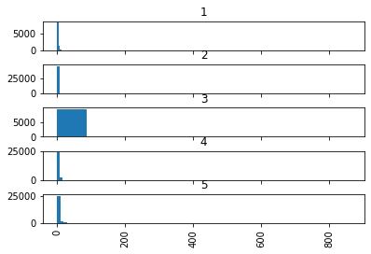
Distance
Class | Num
Tanker | 1
Recreational | 2
Fishing | 3
Cargo | 4
Tugs | 5

Slide 4
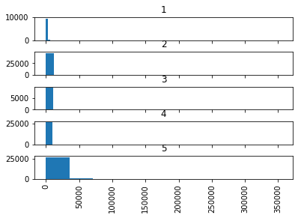
Heading
Class | Num
Tanker | 1
Recreational | 2
Fishing | 3
Cargo | 4
Tugs | 5

Slide 5
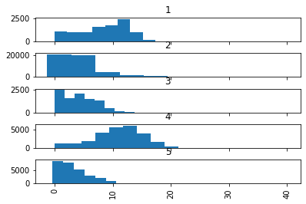
Mean Speed
Class | Num
Tanker | 1
Recreational | 2
Fishing | 3
Cargo | 4
Tugs | 5

Slide 6
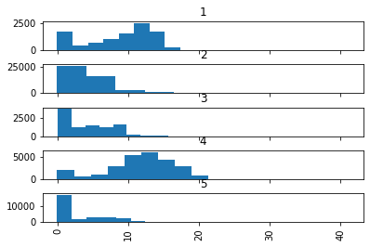
Median Speed
Class | Num
Tanker | 1
Recreational | 2
Fishing | 3
Cargo | 4
Tugs | 5

Slide 7
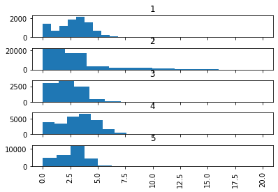
Std Speed
Class | Num
Tanker | 1
Recreational | 2
Fishing | 3
Cargo | 4
Tugs | 5

Slide 8
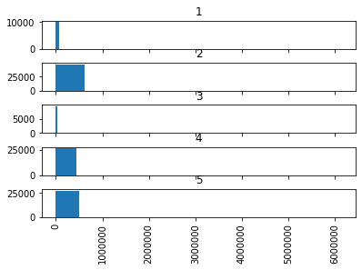
Norm heading
Class | Num
Tanker | 1
Recreational | 2
Fishing | 3
Cargo | 4
Tugs | 5

Slide 9
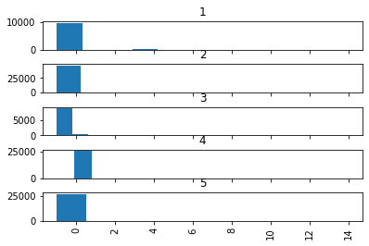
Status
Class | Num
Tanker | 1
Recreational | 2
Fishing | 3
Cargo | 4
Tugs | 5

Slide 10
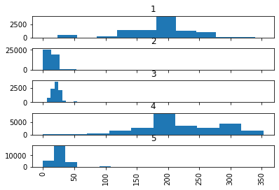
Len
Class | Num
Tanker | 1
Recreational | 2
Fishing | 3
Cargo | 4
Tugs | 5

Slide 11
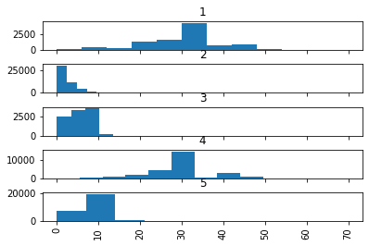
Width
Class | Num
Tanker | 1
Recreational | 2
Fishing | 3
Cargo | 4
Tugs | 5

Slide 12
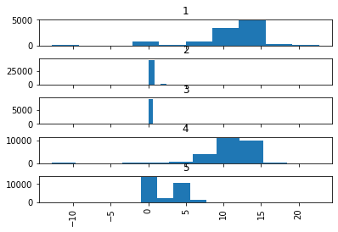
Draft
Class | Num
Tanker | 1
Recreational | 2
Fishing | 3
Cargo | 4
Tugs | 5

Slide 13

Class
Class | Num
Tanker | 1
Recreational | 2
Fishing | 3
Cargo | 4
Tugs | 5

Slide 14
Initial model using only Speed, Speed var, normalized heading rate, distance, the random forest model could not distinguish between freighter/cargo vessels and tankers.
Rerun model with those two classes combined.

Slide 15
Model Performance
Training: 0.98
Test: 0.90
Training:
[[28802 85 3 66]
[ 123 37009 54 196]
[ 18 510 6979 47]
[ 91 680 70 21381]]
Test:
[[6763 152 8 316]
[ 230 7542 390 1184]
[ 22 1028 529 310]
[ 311 1514 253 3477]]

